Slide 1
BANK LOAN ANALYSIS
NAME: ALEEVA DASH

Slide 2
DESCRIPTION
In order to monitor and assess our bank's lending activities and performance, we need to create a comprehensive Bank Loan Analysis. This analysis aims to provide insights into key loan-related metrics and their changes over time. The analysis will help us make data-driven decisions, track our loan portfolio's health, and identify trends that can inform our lending strategies

Slide 3
Key Performance Indicators (KPIs) Requirements:
Total Loan Applications: We need to calculate the total number of loan applications received during a specified period. Additionally, it is essential to monitor the Month-to-Date (MTD) Loan Applications and track changes Month-over-Month (MoM).
Total Funded Amount: Understanding the total amount of funds disbursed as loans is crucial. We also want to keep an eye on the MTD Total Funded Amount and analyse the Month-over-Month (MoM) changes in this metric.
Total Amount Received: Tracking the total amount received from borrowers is essential for assessing the bank's cash flow and loan repayment. We should analyse the Month-to-Date (MTD) Total Amount Received and observe the Month-over-Month (MoM) changes.
Average Interest Rate: Calculating the average interest rate across all loans, MTD, and monitoring the Month-over-Month (MoM) variations in interest rates will provide insights into our lending portfolio's overall cost.
Average Debt-to-Income Ratio (DTI): Evaluating the average DTI for our borrowers helps us gauge their financial health. We need to compute the average DTI for all loans, MTD, and track Month-over-Month (MoM) fluctuations

Slide 4
Good Loan vs Bad Loan
Good Loan KPIs:
Good Loan Application Percentage: We need to calculate the percentage of loan applications classified as 'Good Loans.' This category includes loans with a loan status of 'Fully Paid' and 'Current.'
Good Loan Applications: Identifying the total number of loan applications falling under the 'Good Loan' category, which consists of loans with a loan status of 'Fully Paid' and 'Current.'
Good Loan Funded Amount: Determining the total amount of funds disbursed as 'Good Loans.' This includes the principal amounts of loans with a loan status of 'Fully Paid' and 'Current.
Good Loan Total Received Amount: Tracking the total amount received from borrowers for 'Good Loans,' which encompasses all payments made on loans with a loan status of 'Fully Paid' and 'Current

Slide 5
Bad Loan KPIs:
Bad Loan Application Percentage: Calculating the percentage of loan applications categorized as 'Bad Loans.' This category specifically includes loans with a loan status of 'Charged Off.'
Bad Loan Applications: Identifying the total number of loan applications categorized as 'Bad Loans,' which consists of loans with a loan status of 'Charged Off.'
Bad Loan Funded Amount: Determining the total amount of funds disbursed as 'Bad Loans.' This comprises the principal amounts of loans with a loan status of 'Charged Off.'
Bad Loan Total Received Amount: Tracking the total amount received from borrowers for 'Bad Loans,' which includes all payments made on loans with a loan status of 'Charged Off

Slide 6
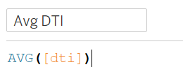
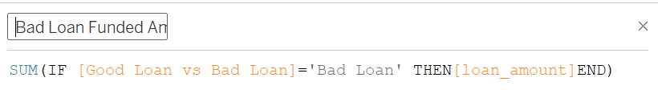
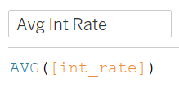
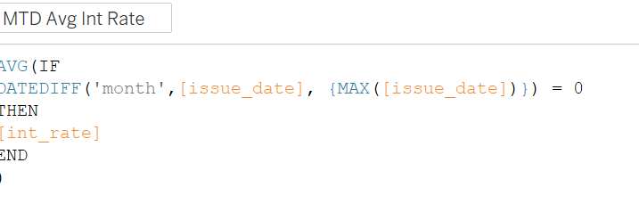
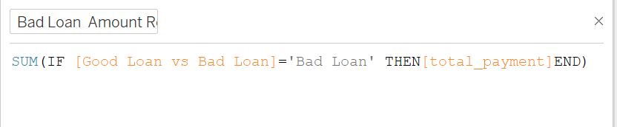
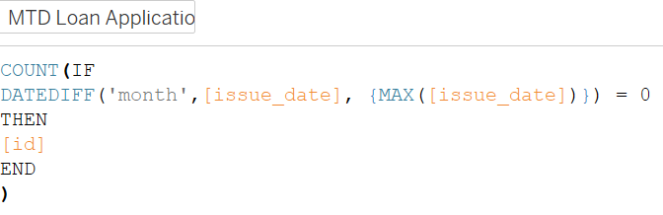
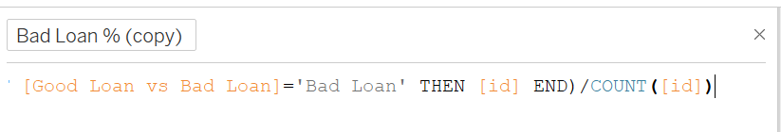
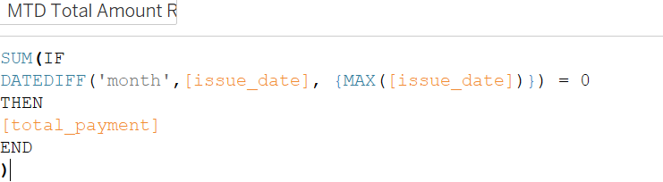
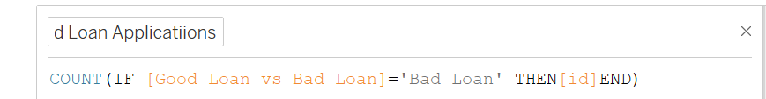
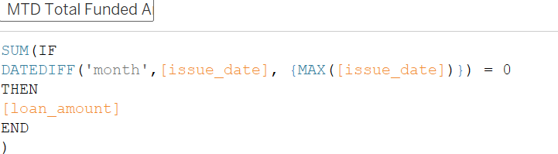
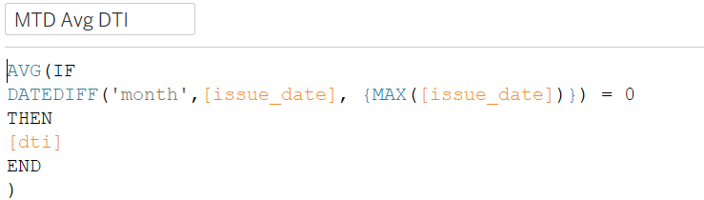
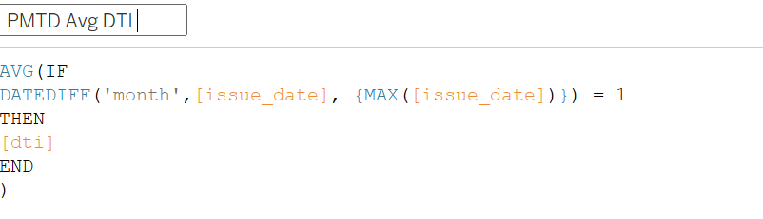
FORMULAS

Slide 7
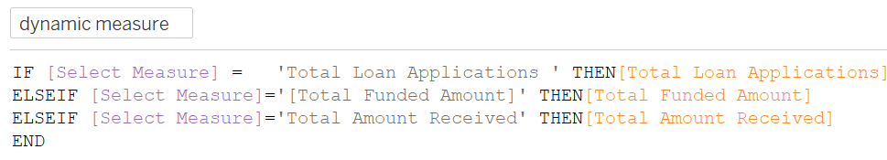
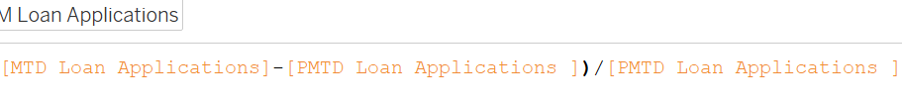
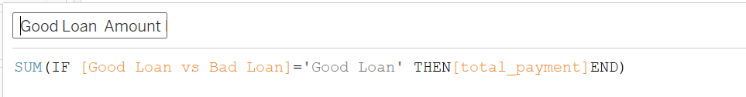
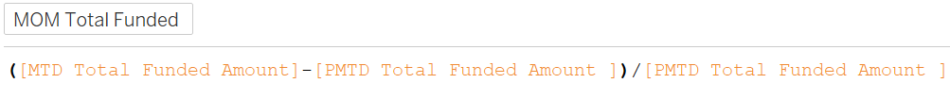
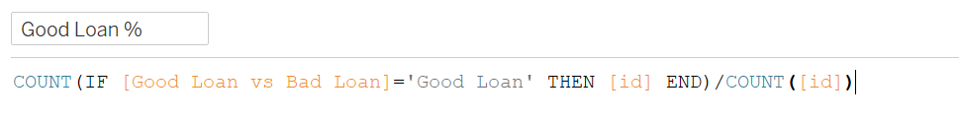
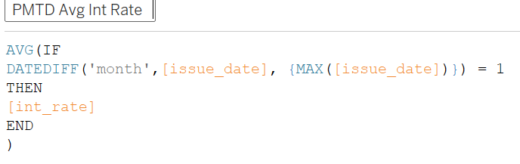

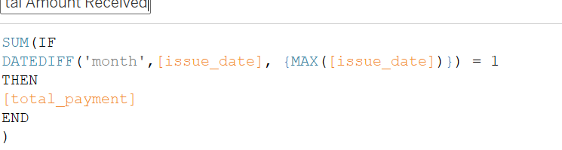
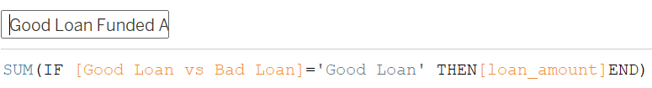
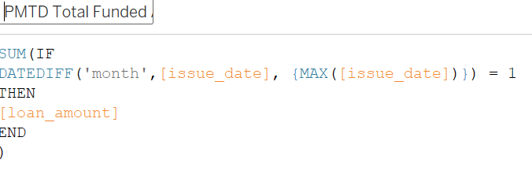
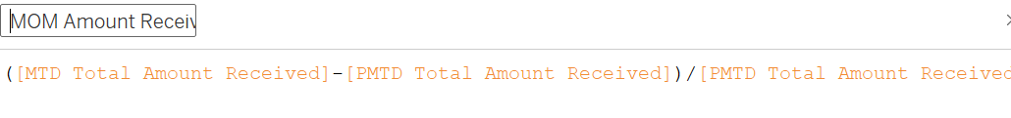

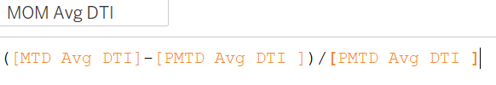

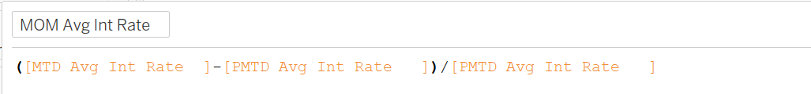


Slide 8
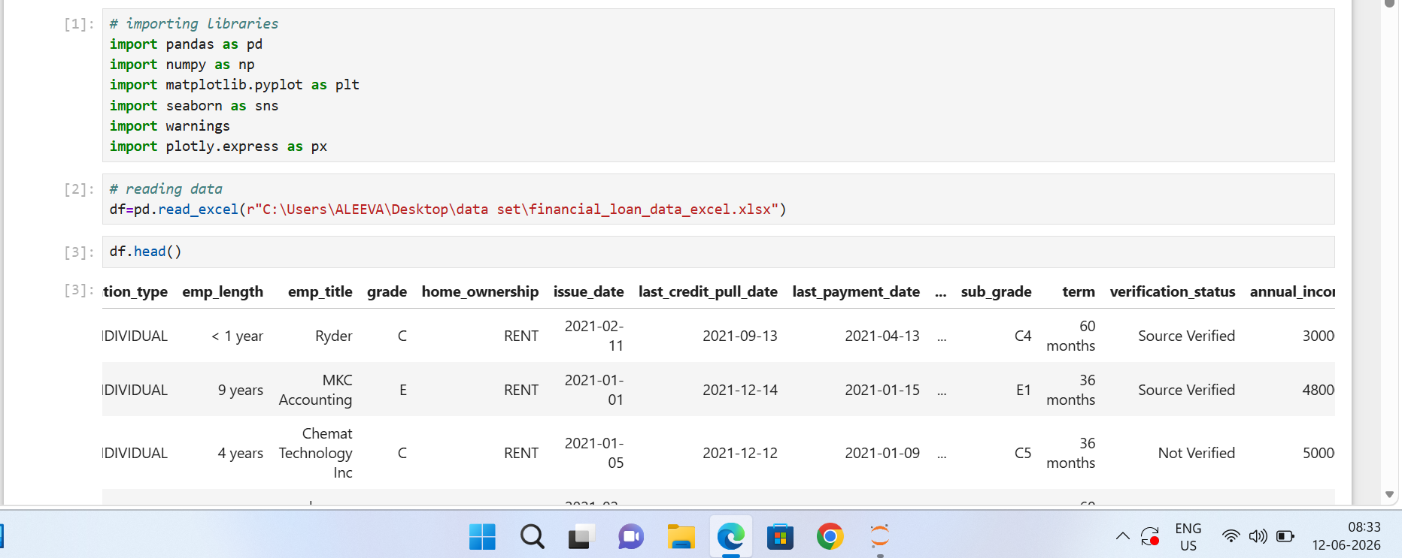
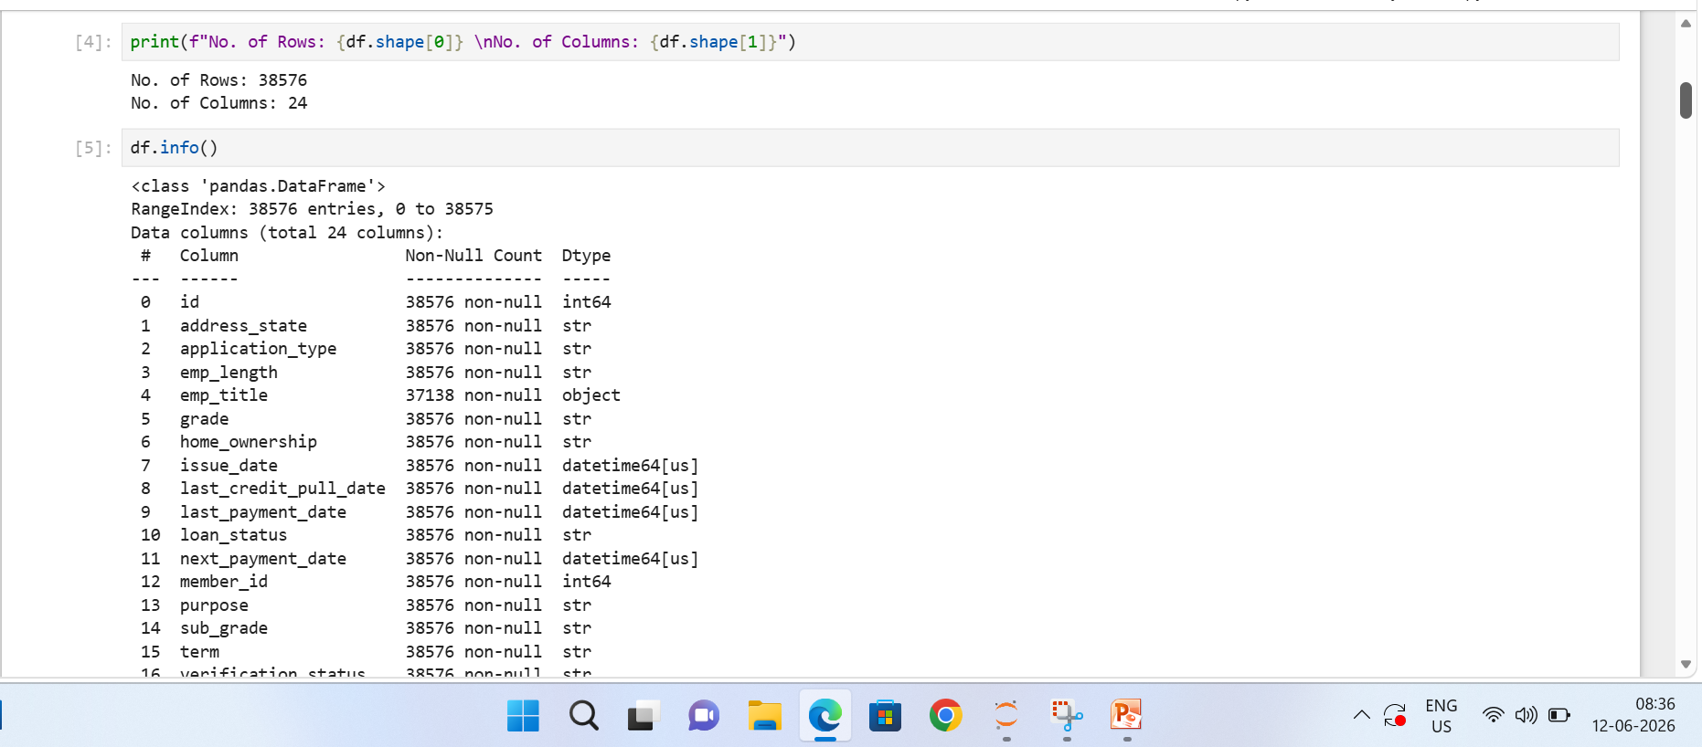
DATA CLEANING AND DATA ANALYSING USING PYTHON

Slide 9
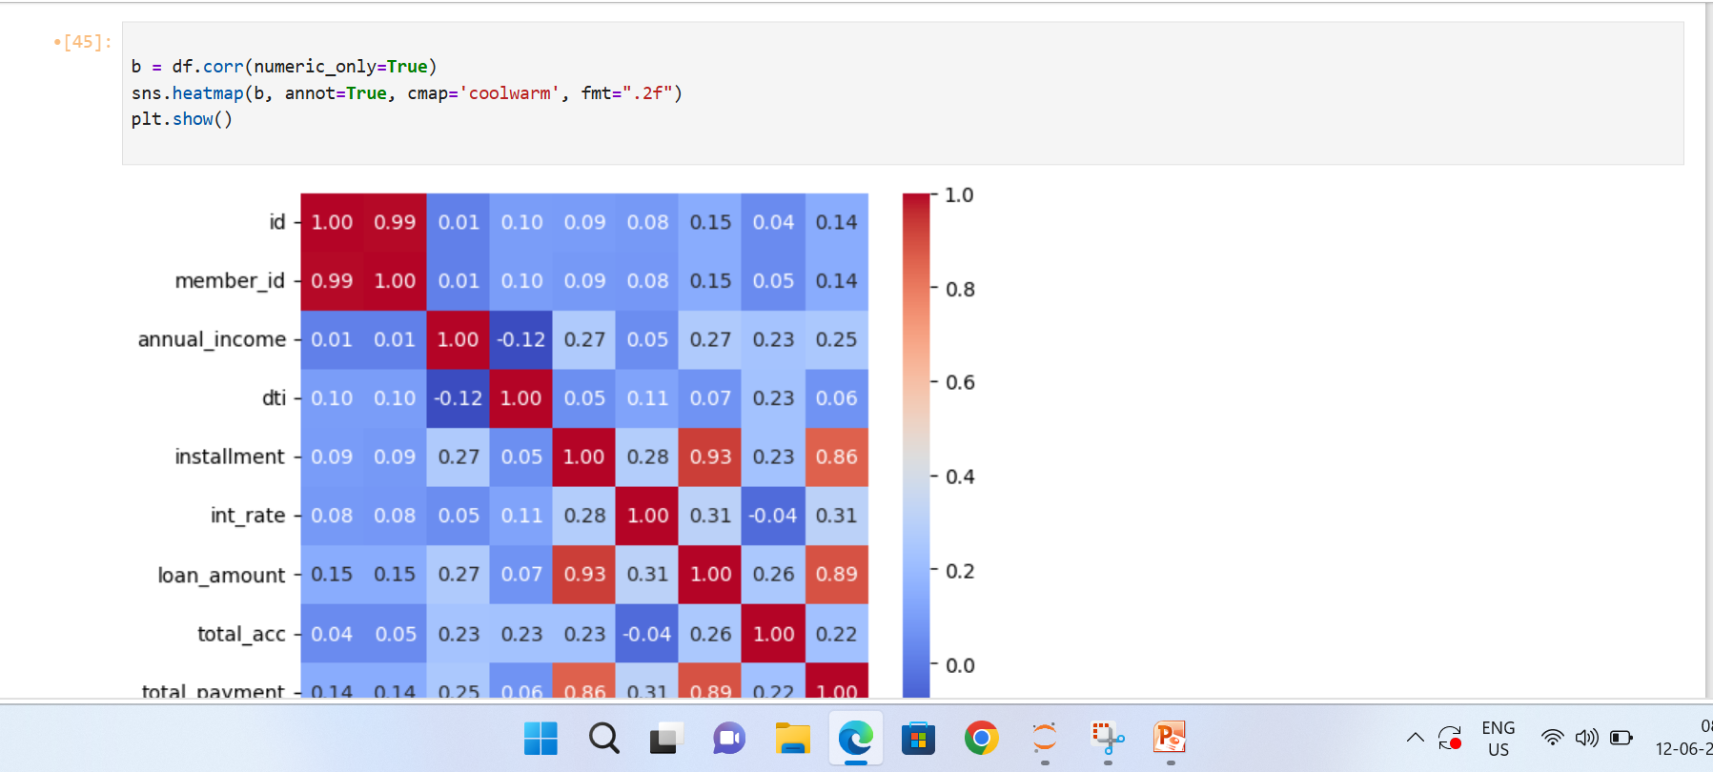
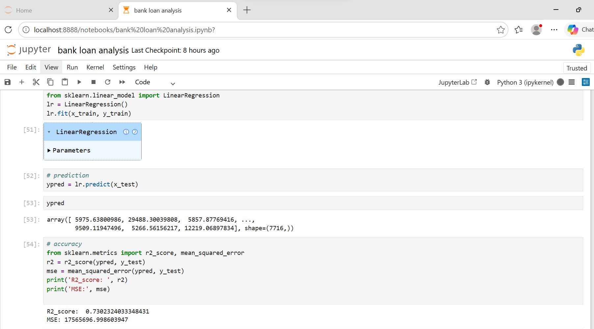

Slide 10
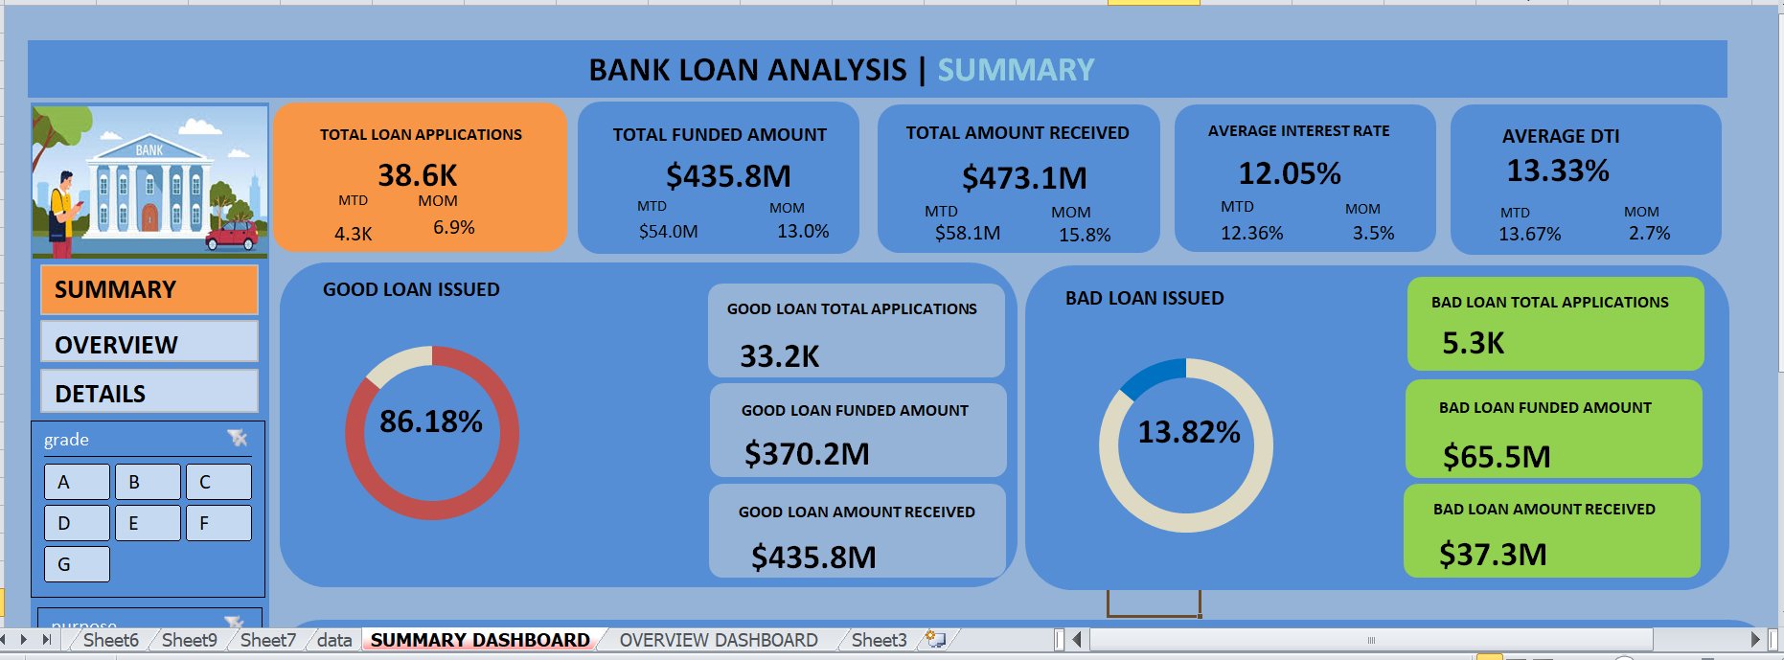
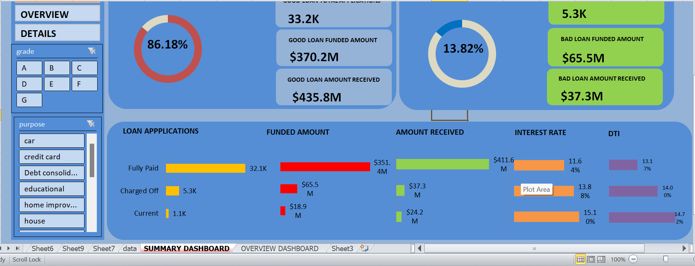
DASHBOARD EXCEL

Slide 11
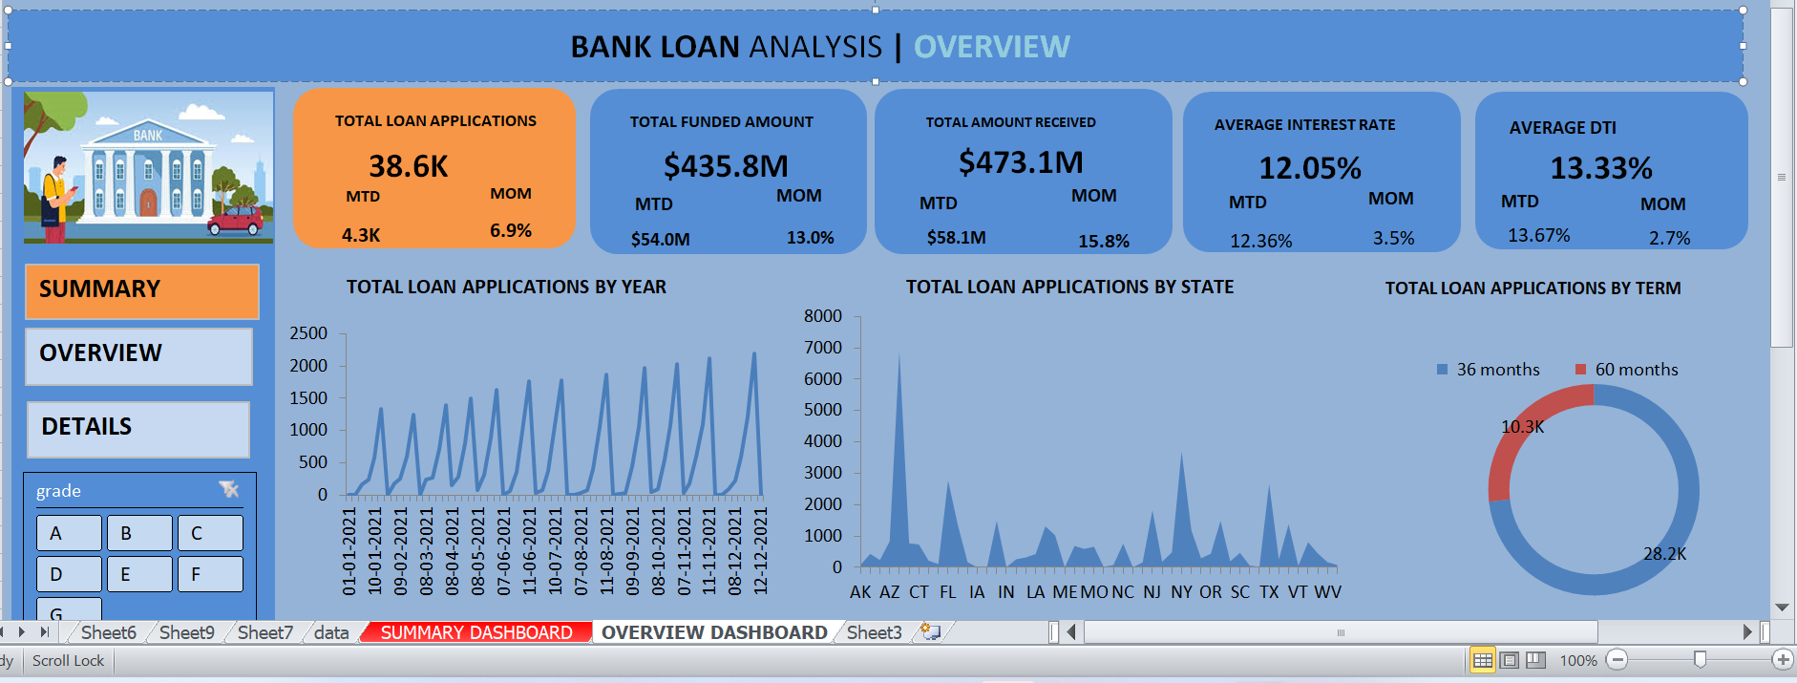
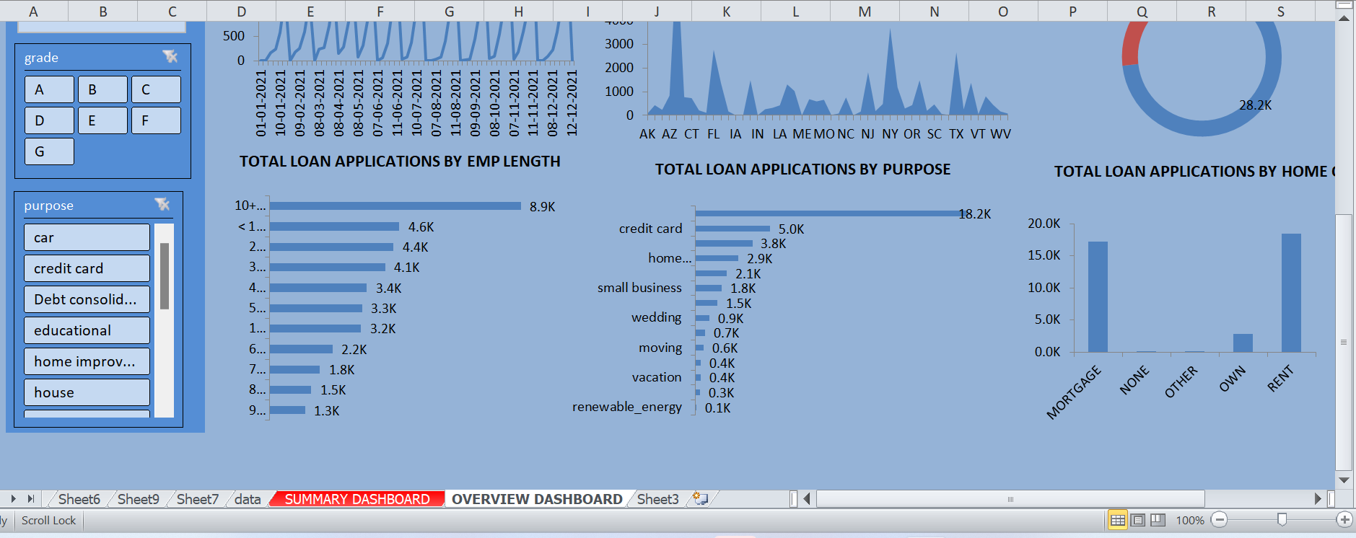

Slide 12
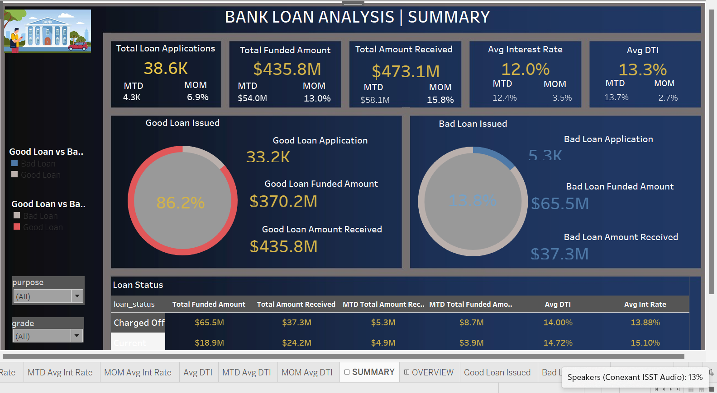
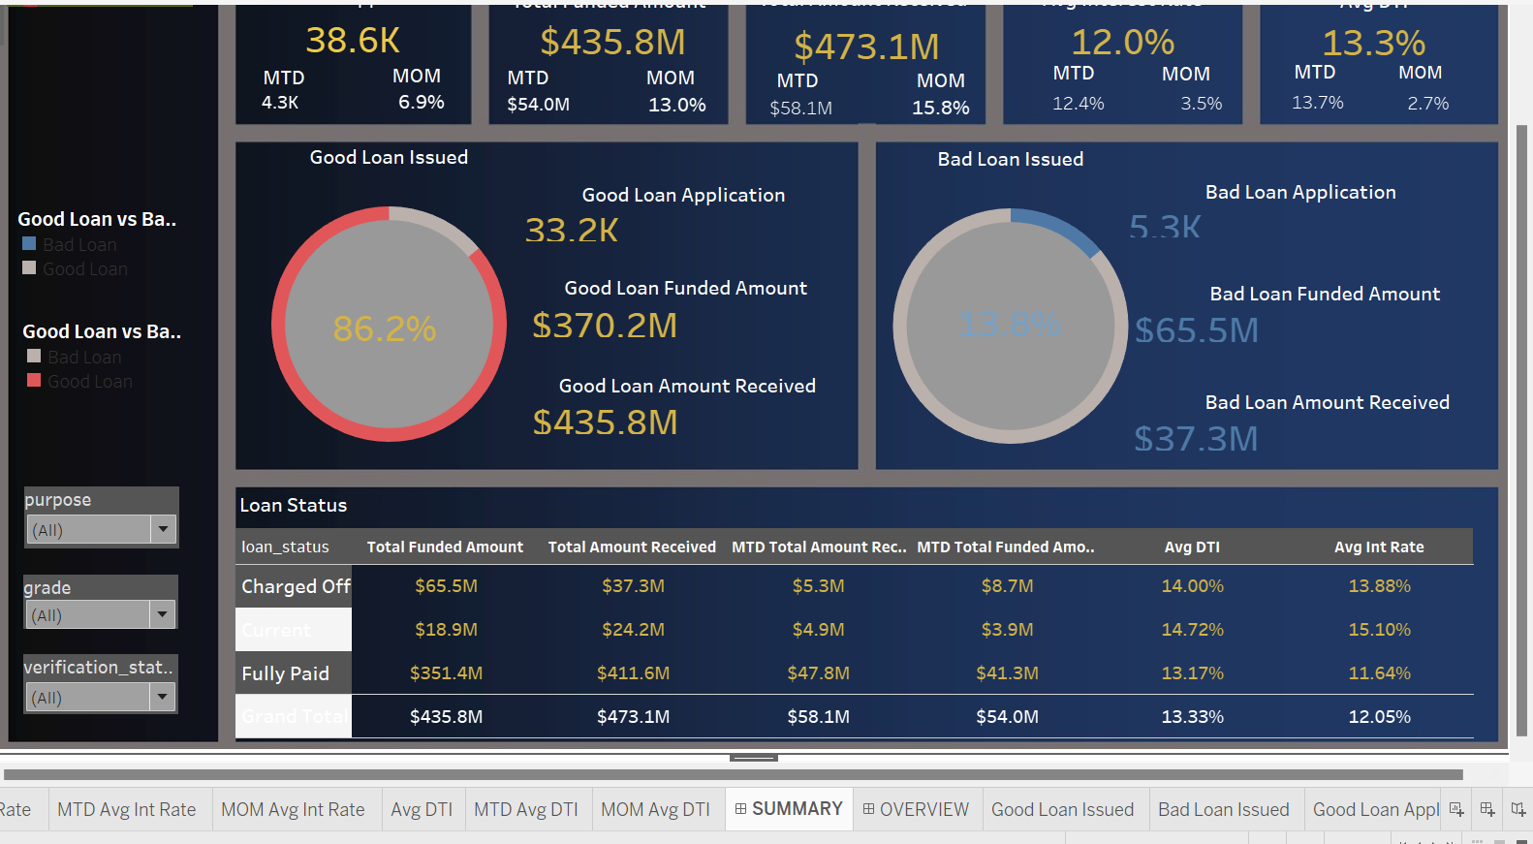
DASHBOARD TABLEAU SUMMARY

Slide 13
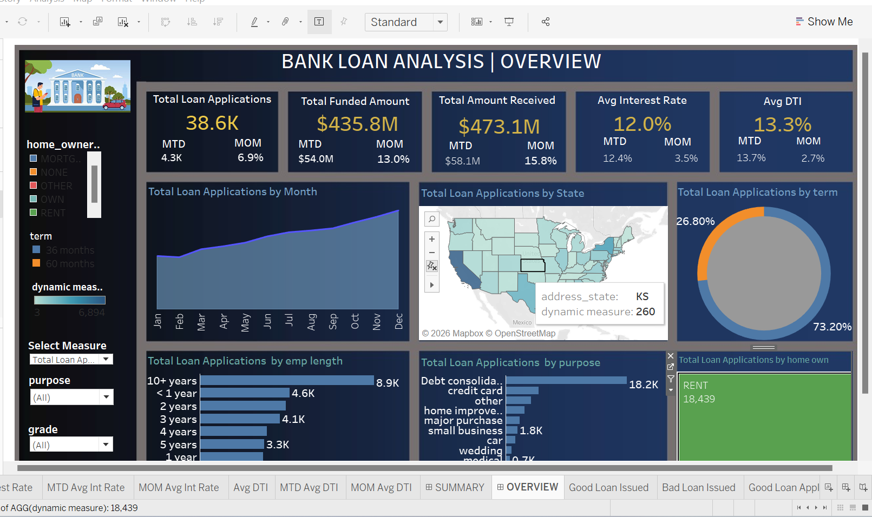
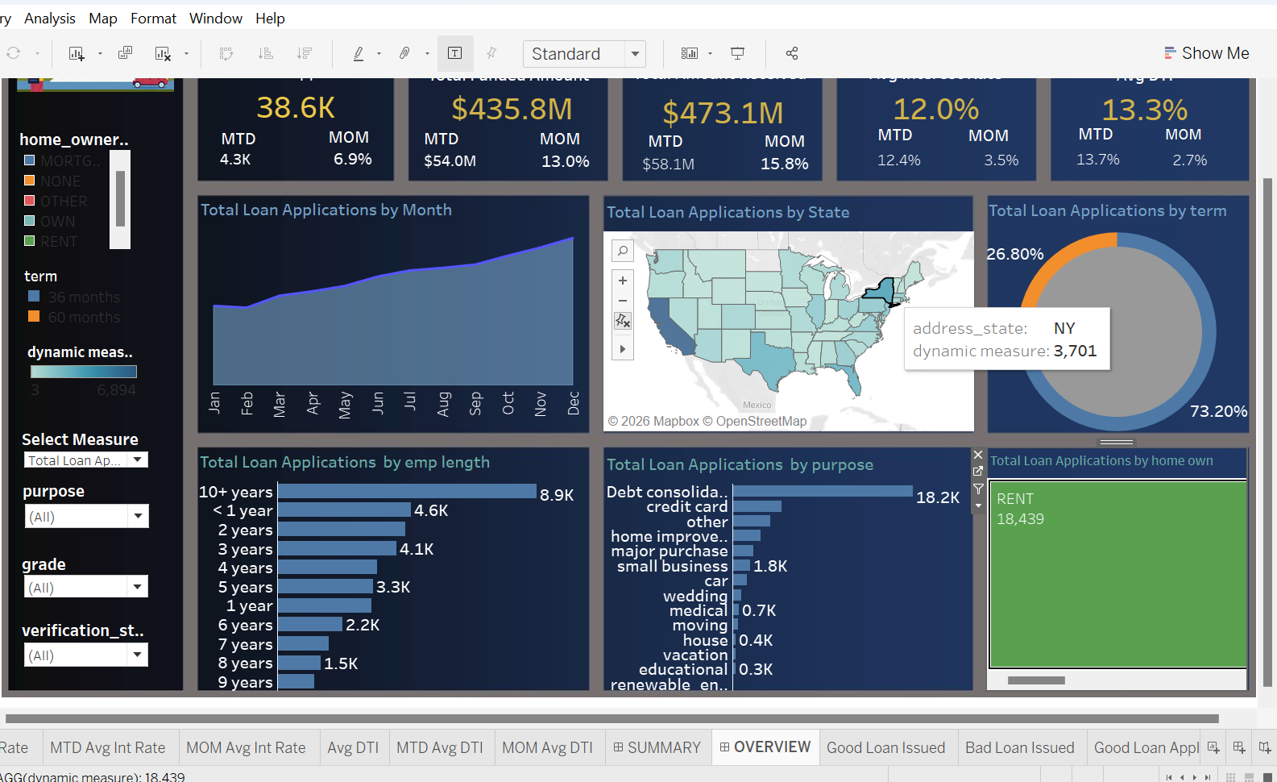
DASHBOARD TABLEAU OVERVIEW

Slide 14
THANK YOU

